Slide 1


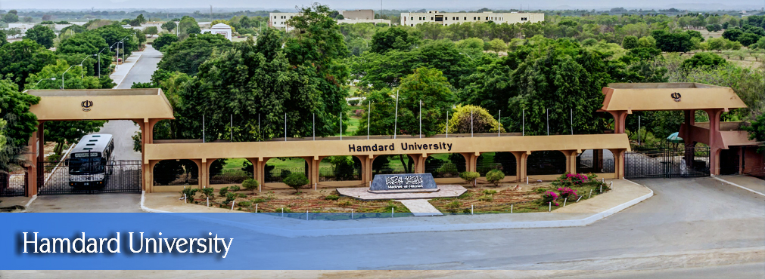
Synergizing Human Behavior and Cybersecurity using Psychometric Behavioral Analysis
FYP Proposal
Syeda Areej Asif | (2276-2021)
Shahreen Sheikh | (1771-2021)
Farees Fatima | (1755-2021)
Supervisor Jibran Rasheed Khan
Hamdard University

Slide 2
Problem Statement
“Human undermine Cybersecurity”
Despite advancements in technological defenses, human behavior remains a critical vulnerability and often represent the weakest link in cybersecurity. Current solutions often overlook the human element, leading to persistent security breaches.

Slide 3
Project Introduction
Cybersecurity has become a paramount concern for and organizations of all sizes and every individuals.
Traditional methods of safeguarding digital assets are no longer sufficient to combat the sophisticated cyber threats.
Human behavior analysis assessments offers a promising approach to minimize the breaches and to strengthen the weakest link.
Understanding the psychological and behavioral tendencies of individuals, can create more robust and adaptive security strategies.
Psychometric assessments provide valuable insights into how people perceive, react to, and handle various situations.

Slide 4
Project Objectives
To identify key behavioral indicators/factors Determine specific behavioral traits and actions that serve as reliable predictors of whether an individual is likely to adhere to security regulations.
To analyze the correlation between human factors and security Investigate how individual behavioral patterns impact adherence to security protocols within an organization.
To develop a psychometric scale for assessing security Create and validate a psychometric tool that accurately measures an individual's propensity to comply with security policies based on their behavioral traits.

Slide 5
Project Scope
The scope of project includes and limited to conducting a comprehensive literature review on existing research, creating a psychometric scale to assess relevant personality traits, cognitive abilities, and behavioral tendencies, designing and administering a survey to collect data on security behaviors and attitudes, analyzing the survey data to identify key patterns, their correlations, and preparing a detailed report on the findings, including data analysis and recommendations.

Slide 6
Project Methodology
Mixed-Methods Research Methodology
WHY?
This methodology allows for a thorough investigation of human factors in cybersecurity by combining the strengths of both qualitative and quantitative research, providing a well-rounded and in-depth understanding of the subject matter.

Slide 7
Project Methodology
Design Research Questions
Qualitative
Literature Review
Qualitative
Psychometric Scale Development
Quantitative
Qualitative and Quantitative
Quantitative
Design and Administrate Survey
Data Analysis
Qualitative and Quantitative
Document & Reporting

Slide 8
Project Role & Responsibilities
Task/Activity | Areej Asif | Shahreen | Farees | Mr. Jibran
Project Planning | R,A | R | R | C,I
Literature Review | R,A | R | R | C,I
Identifying Factors | C.I | R,A | R | C,I
Design Scale | R,A | I | R | C,I
Design Survey | R,A | R,A | R | C,I
Conduct Survey | C.I | R,A | I | C,I
Analyze Data | R,A | R,A | R | C,I
Assessment Report | R,A | I | R | C,I
Documentation | A,I | R | R,A | C,I

Slide 9
Project Plan
Task/Activity | Duration
Project Initiation and Planning | 2 weeks
Literature Review | 14 weeks
Psychometric Scale Development | 8 weeks
Survey Design and Administration | 3 weeks
Data Collection and Preprocessing | 3 weeks
Data Analysis | 3 weeks
Integration of Findings | 4 weeks
Reporting | 3 weeks
Project Reports and Draft Paper | 8 weeks
Total Estimated Duration | weeks

Slide 10
Project Budgeting
Estimated budget of project major resources
Developers (3 @ 700 x 4days x 4 week = 33600 x 12 = PKR 403,200 est.)
Hard Drive (Rs. 14,000 x 2 = PKR 28,000 est.)
Laptop (Rs. 150,000 x 3 = PKR 450,000 est.)
Electricity (Rs. 5000 x 12 = PKR 60,000 est.)
Internet (3000 x 12 = PKR 36,000 est.)
Industry Expert Consultancy (expected 2-4 visits) 8000 x 2 = PKR 16,000 est.
LaserJet Printer 16,000
Miscellaneous PKR 10,000 est.
Total cost PKR 1,118,200‬ est.
*Detailed budget sheet will be provide.

Slide 11
Project Tools
Software Requirements
Hardware Requirements
MS Word, MS Excel
Python
Mendeley Desktop & Web
Overleaf
TurnitIn
Laptop (Multi-Core, i9, 16GB, 500GB SSD)
Backup Hard drives
Internet dongle
Printer

Slide 12
8- Project Deliverables
FYP-I Evaluation
FYP-II Evaluation
Project Plan
Methodology
Detailed Literature Survey
Project Report – I
Research Paper (First draft)
Preliminary Result
Poster
Project Report – II
Research Paper (Final draft or with submission status only)

Slide 13
THANK YOU!

